Slide 1
All Hail the Chief
Contest Chief Judge Training
District 7 Toastmasters

Slide 2
Agenda
Role, Rules & Paperwork
Teamwork Makes the Dreamwork
It’s All About the Briefing
It’s Finally Here: Contest Day
Ballot Scoring, Counting and More
Q&A
Available Resources

Slide 3
Chief Judge’s Role
Ensures contest protocol is always followed
Appoints Voting Judges, Ballot Counters and Timers
Ensure contest officials understand their roles
Supervise collection and counting of ballots
Verify results and deliver to Contest Chair

Slide 4
Know the Rules!
2022-2023 Explanation of Changes
2022 – 2023 Contest Rulebook
2022-2023 Online & Hybrid Speech Contest Best Practices

Slide 5
Paperwork in Order
Judge’s Certification of Eligibility & Code of Ethics (1170)
Judge’s Guide and Ballots (1172, 1191)
Tie Breaking Judge Guide & Ballot (1188, 1191A)
Time Record Sheets (1175)
Ballot Counter’s Tally Sheets (1176)
Contest Rulebook (1171)
Contest Script
Briefing Script
Results Form (1168)
Notification of Winners (1182)
Download speech kits from D7 website.

Slide 6
Minimum Officials Needed?
Club Contest(s):
5 Voting Judges + 1 Tiebreaking Judge + 1 SAA + 2 Ballot Counters + 2 Timers*
Area Contest(s):
Equal representation from each Club in Area - OR, 5 Voting Judges
1 Tiebreaking Judge + 1 SAA + 2 Ballot Counters + 2 Timers
Division Contest(s):
Equal representation from each Area in Division - OR, 7 Voting Judges
1 Tiebreaking Judge + 1 SAA + 2 Ballot Counters + 2 Timers
Chief Judge and Voting Judges must not be a club member of a contestant
District Contest(s):
Equal representation from each Area in Division- OR, 7 Voting Judges
1 Tiebreaking Judge + 1 SAA + 3 Ballot Counters + 3 Timers
Chief Judge and Voting Judges must not be a club member of a contestant
* Unless impractical

Slide 7
Choosing Your Team
Coordinate with Contest Chair to enlist the contest officials (at least 2 months before contest date)
Contact Area Director, Division Director, D7 Contest Chair and/or D7 Chief Judge for list of possible officials
Know who’s eligible and not eligible
Eligibility Assistant
Toastmaster’s Profile (Education Requirement)

Slide 8
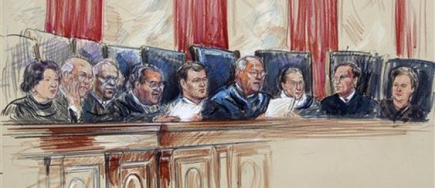
Voting Judge - Who’s Eligible
Voting Judge Eligibility Requirements:
Club Contest(s): Paid member
Area, Division or District Contest(s):
Paid member minimum of six months
Completed minimum 6 speeches in CC or Pathways Level 1 and 2
Physically present @ contest
Must not belong to same club as contestant

Slide 9
Voting Judge – Who’s N T Eligible
Member competing in contest or intends to compete
Candidates for elected District leader positions beginning July 1 are ineligible
Trio Members
District Director
Program Quality Director
Club Growth Director
Division Directors
Area Directors

Slide 10
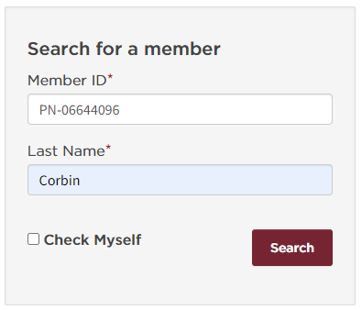
Eligibility Assistant
This tool allows club and district officers to check membership status, club status and if a member is serving as a club or district officer. This information can be used when determining whether or not members are eligible to compete in speech contests.
Note: Club officers can only check the eligibility of members within their own clubs. The same restrictions apply to district leaders. Area director can only check members with their area, a division director can only check members within their division and a district director can only check members within their district.
Click to view Eligibility Assistant
Be sure to review the Speech Contest Rulebook (Item 1171) for complete eligibility requirements.

Slide 11
Eligibility Assistant (Cont.)

Slide 12
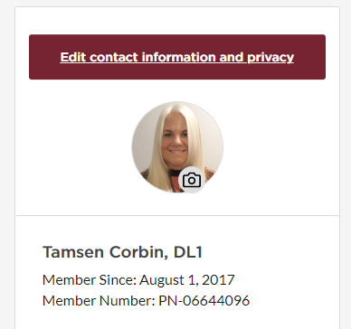
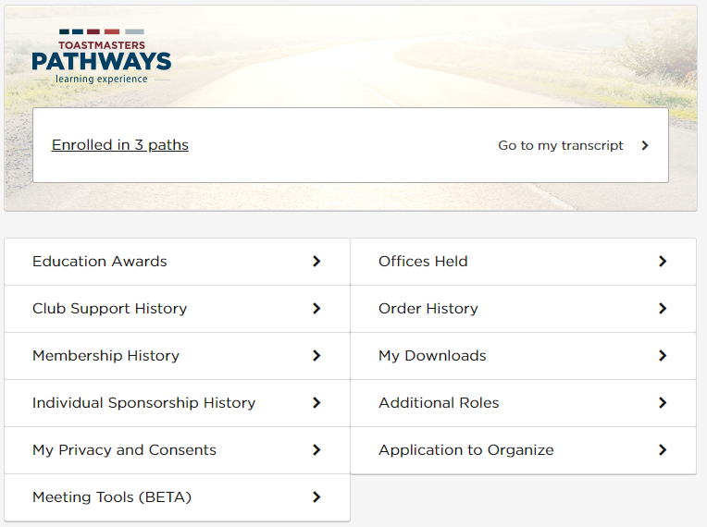
Education Requirement
Log into Toastmasters and click on My Profile

Slide 13
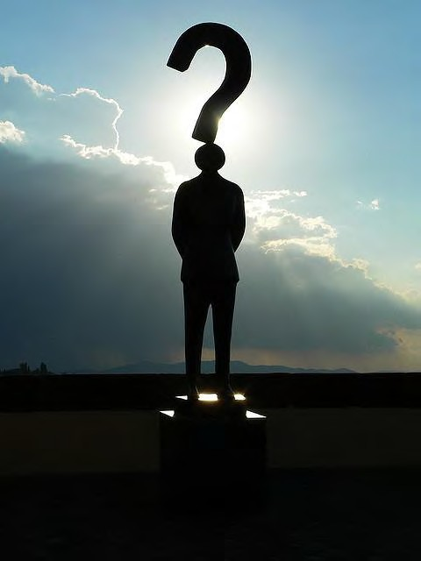
Tiebreaking Judge
Follow rules and guidelines set forth for a voting judge
Should be from outside Club, Area, Division or District
Briefed separately
Must rank all speakers not just top 3
Ballot only seen if there is a tie

Slide 14
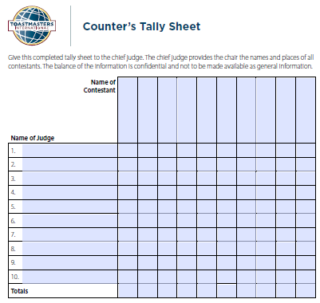
Ballot Counter
Role: Tally the ballot from each judge
Briefed by Chief Judge
During contest, remain muted with camera off
After final speaker, moved into Chief Judge’s Room
Note: Division & District Contest: 1 Ballot Counter will be zoom qualified to move Judges between BOR

Slide 15
Timer w/ Lights
Role: Time each speech and show the D7 approved TI background at correct time
Briefed by Chief Judge or D7 Zoom Chair
Always remain muted with camera off
After final speaker, moved into Chief Judge’s Room to report time
Note: Division & District Contest: Timer w/ Lights will be zoom qualified

Slide 16
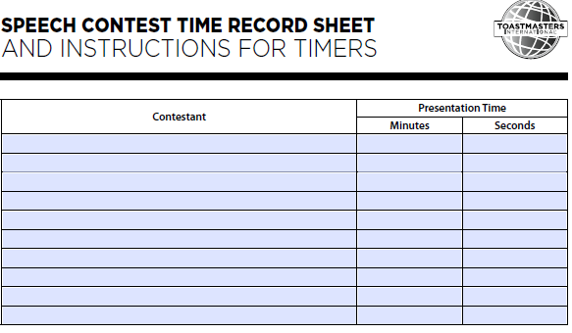
Timer with Stopwatch
Role: Keep official record of speech & advise Toastmaster of 1 minute of silence by showing red zoom background
Briefed by Chief Judge prior to contest
During contest, camera to be off and
remain muted
After final speaker, moved into Chief Judge’s Room to advise of any time disqualification.

Slide 17
Sergeant At Arms (SAA)
Role: Move Judges between Judges Breakout Room (BOR) and Chief Judge BOR
Briefed by Chief Judge or D7 Zoom Chair
Remain muted with camera off
After final speaker, moved into Judge’s Room to move judges to Chief Judge’s room to cast ballot
Note: Division & District Contest: SAA will be zoom qualified

Slide 18
Prior to Contest Briefings
Send email with Contest Brief date and time including the following attachments:
Judge:
Judge’s Eligibility & Code of Ethics form
Judge’s Guide and Ballot (for each type of contest)
2022-2023 Contest Rulebook
Timers:
Time Record Sheet and Instructions
Timer Zoom backgrounds
Ballot Counters:
Counter Talley Sheet
Sergeant At Arms (SAA)
Suggest they attend training: Judge or
Zoom Contest Training
See D7 Event Calendar for listing

Slide 19
Contest Staff Briefings
Strongly suggest to schedule briefings BEFORE the day of the contest (Area, Division & District contests)
Judges (briefed separately from other functionaries)
Tiebreaking Judge (solo briefing)
SAA, Timers & Ballot Counters (briefed by Chief Judge/D7 Zoom Chair)
Division/District Contests – SAA, Timer w/ Lights and Ballot Counter #1 are zoom qualified
Typically, Contest Chair briefs the Contestants

Slide 20
Contest Judge Briefings
Request missing Judge’s Eligibility & Code of Ethics forms (1170)
Review rules & contest standards: “Speaking Area”, “Originality”, “Technical Difficulty”, “Timing”, etc.
Discuss the protocol and handling of protests
Explain voting / completing the Ballot
Provide the Speaking Order
Sample Chief Judge Briefing Script

Slide 21
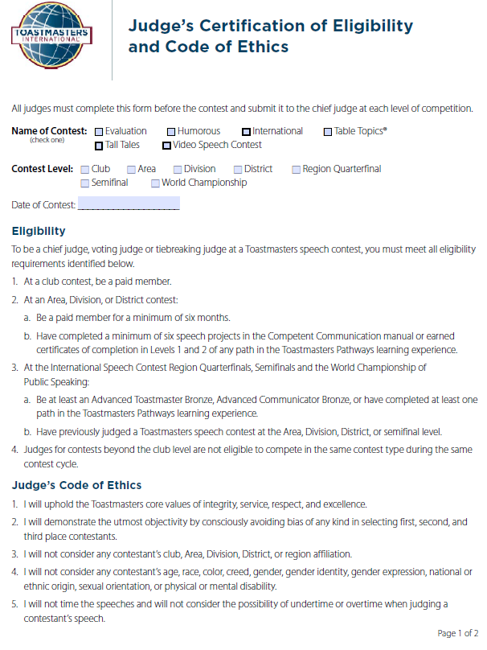
Judge’s Eligibility & Code of Ethics
Per Contest, Judges must complete the Judge’s Certification of Eligibility and Code of Ethics form and return to the Chief Judge prior to the contest date.

Slide 22
Protest Too Much
Only made by judges & contestants
If question regarding originality or eligibility, don’t allow to affect your scoring of the speech
Lodged with Chief Judge or Contest Chair
Must be made before winner announcement
Contest Chair to notify disqualification

Slide 23
You’re Disqualified
Violating eligibility rules
Violating originality rules
> 25% quoting or paraphrasing
Failing to provide reference
referencing other person’s content
Speaking under or over time
Referencing another speaker during your speech

Slide 24
Prior to Contest Day
Schedule & attend a contest run through with Contest Chair, Toastmaster, Zoom Team, Timer w/ Lights, and SAA
Send the list of officials with contact information (email and telephone number) to ZML / Zoom Admission Master (do not share)
Send contest script to Contest officials & ZML
Review the contest script
Send email reminder with contest zoom link and
sign in times

Slide 25
Contest Day
Log in early to check in with Contest Chair & Contest Toastmaster
Test audio and video
Visit Judge’s ‘Green Room’ to answer any last-minute questions
Ensure all officials are present / Contact anyone missing
Follow script
Acknowledge officials have been briefed
Monitor Timer w/ Lights
Ensure protocols are followed

Slide 26
Completing Your Ballot
Rank the top 3 contestants
No ties (if a tie, review notes & decide rank before completing ballot)
Valid ballots must be signed, and name printed
Show only bottom of ballot to the Ballot Counters and Chief Judge

Slide 27
Tiebreaking Judge Ballot
Must rank ALL contestants, not just the top 3
Tie breaker ballot will not be viewed or counted, UNLESS after counting the voting judges ballots there is a TIE.

Slide 28
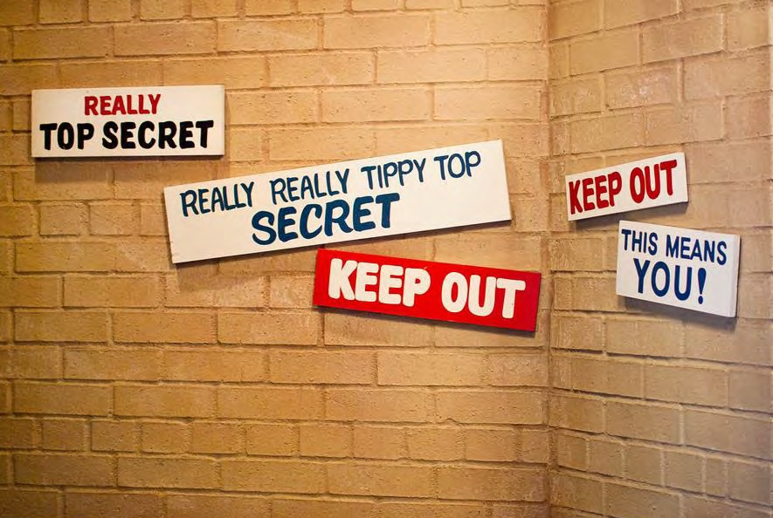
Ballot Counting Protocol
What happens in the ballot-counting room…
…STAYS in the ballot-counting room.

Slide 29
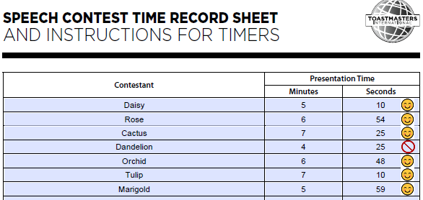
Check for Time Disqualifications
Timer w/ Lights and Timer #2 moved to the Chief Judge BOR to show Time Record Sheet
Humorous Speech & International Speech timing (5-7 mins):
Qualify:
> 4 min 30 sec
< 7 min 30 sec
Upload Time Sheet in Chat to Chief Judge

Slide 30
Show Me Your Vote
Following final speaker, Judges are moved to the Judge’s
BOR to finalize their ballot
Raise hand when ballot complete
SAA to move Judges 1 by 1 to the Chief Judge’s
BOR to show ballot
Following ballot reveal, Ballot Counter #1 to move Judge back to Main Session

Slide 31
Checking the Ballot
Rank only top 3 contestants
No ties (if a tie, review notes & decide rank before completing ballot)
Valid ballots must be signed, and name printed
Show only bottom of ballot to the Ballot Counters and Chief Judge

Slide 32
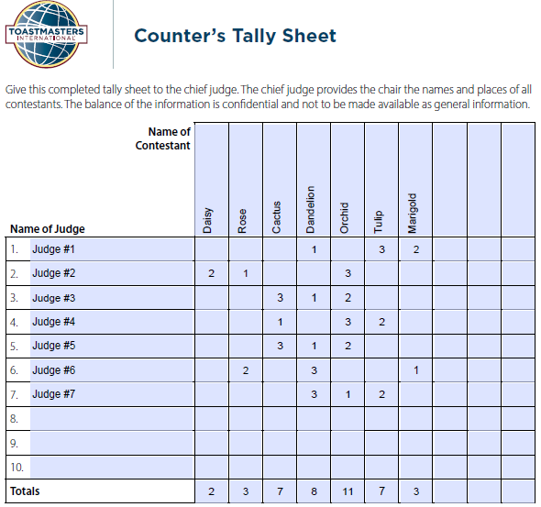
Time to Count the Ballots
Ballot Counter #1 & #2 along with Chief Judge moved to CJ BOR
1 by 1 SAA moves Judges into CJ BOR to show bottom of ballot
Ballot Counter #1 & #2 write down 1st (3 points), 2nd (2 points) and 3rd (1 point)
Check against time disqualifications

Slide 33
What if: Time Disqualification
Time < 4 minutes 30 sec

Slide 34
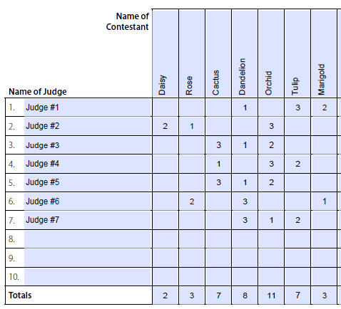
Result: Vote Disregarded
Disqualified contestant’s votes are disregarded

Slide 35
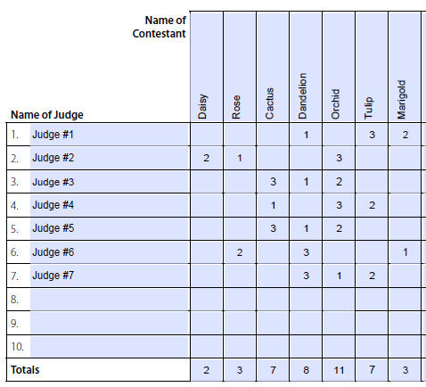
What if: Tie
With the disqualified contestant’s votes thrown out there is now a tie for Second Place

Slide 36
Result: Tie Breaker Ballot
Tie Breaking Judge to the rescue!

Slide 37
What if: Originality Challenge
Originality challenge can be made ONLY by a Judge or Contestant
Challenger should be prepared to offer evidence
Challenged Contestant has opportunity to respond to Judges
Judges vote on whether to disqualify

Slide 38
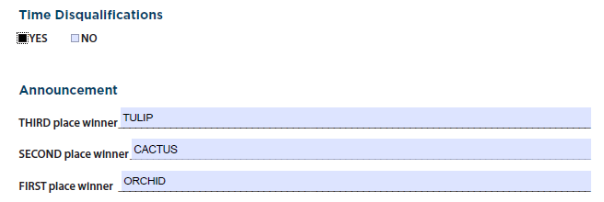
Finalizing the Results

Slide 39
Contest Results
Provide results to the Contest Chair ensuring in reverse order
Chief Judge or Contest Chair prepares 1st, 2nd and 3rd Certificates
If possible, put together a slide deck with above certificates (and include photo of Division or District trophies)
Ensure the results are announced correctly and advise of next level Contest date (i.e., club contest – announce area date)

Slide 40
After the Contest
Take responsibility of
Ballots
Timer Reports
Ballot Counter Sheets
Judge Eligibility Forms
Hold above until next-level contest is completed (Area, Division, District, etc.)
Send results to the next level Contest Chair (Area, Division, District, etc.)
Area & Division Directors send the list of contest officials to chiefjudge@d7toasmasters.org

Slide 41
Send emails to your team, thanking them for their time and support.

Slide 42
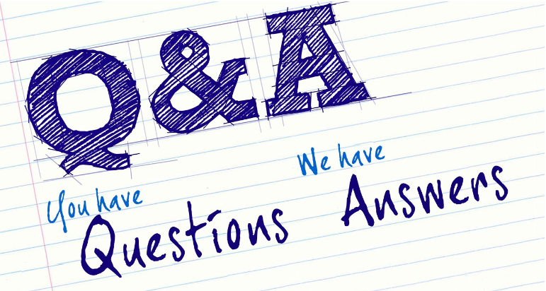

Slide 43
Resources
D7 Contest Resources Page (includes scripts and all contest forms)
2022-2023 Online and Hybrid Contest Best Practices
Speech Contest Rulebook
Conduct Quality Speech Contests
Toastmasters International Contest Tutorials
Eligibility Checker

Slide 44
Thank you for attending Contest Chief Judge Training.
If you or someone you know wants to be a Chief Judge or judge an Area, Division or District contest, please contact the D7 Contest Chief Judge.
Tamsen Corbin, D7 Chief Judge
chiefjudge@d7toastmasters.org
971-978-9070

